Slide 1
Customer Churn Analysis Dashboard
IBM Telco Customer Churn Dataset
Prepared by: Damilola Owolabi
AnalystLab Africa Data Analytics Internship

Slide 2
Business Problem
The company is experiencing customer churn and wants to understand why customers are leaving. This project examines customer behaviour to identify the main factors associated with churn and recommend practical actions that can improve customer retention.
Key Questions
• Why are customers leaving?
• Which customers are most likely to churn?
• Which factors contribute most to churn?
• What actions can improve customer retention?

Slide 3
Dataset Overview
Dataset
IBM Telco Customer Churn Dataset
Overview
Total Customers: 7,043
Duplicate Customer IDs: 0
Missing Values: 11 (Total Charges)
Tool Used: Microsoft Power BI
Data Preparation
Checked for duplicates.
Replaced blank Total Charges values with 0.
Verified data types.
Created DAX measures.
Created Tenure Groups.

Slide 4
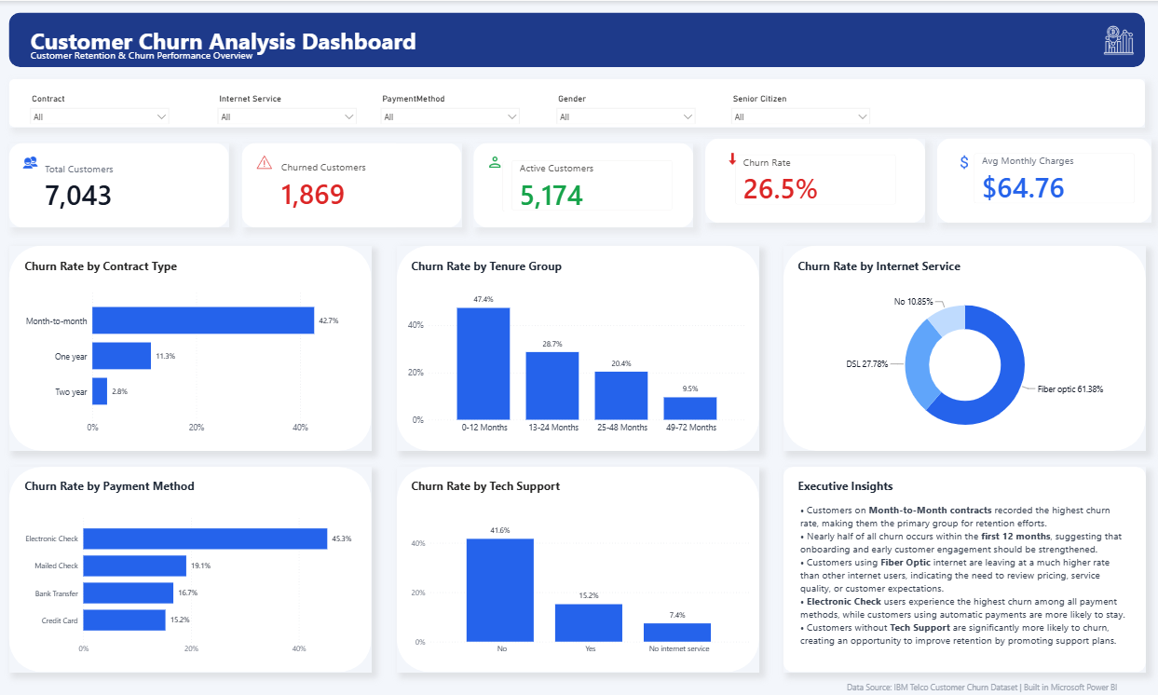
Customer Churn Dashboard
Figure 1. Interactive Power BI Customer Churn Dashboard
The dashboard provides an interactive summary of customer churn and highlights the key factors influencing customer retention.

Slide 5
Key Findings
Key Findings
Overall customer churn rate was 26.5%.
Month-to-Month customers recorded the highest churn.
Customers with 0–12 months tenure were the most likely to leave.
Fiber Optic customers had the highest churn among internet service types.
Customers using Electronic Check had the highest churn.
Customers without Tech Support were significantly more likely to churn.

Slide 6
Recommendations
Recommendations
Introduce retention offers for Month-to-Month customers.
Strengthen customer onboarding during the first 12 months.
Review the Fiber Optic service to identify possible issues affecting customer satisfaction.
Encourage customers to use automatic payment methods.
Promote Tech Support services to customers who are not currently subscribed.
These recommendations can help improve customer retention and reduce churn over time.

Slide 7
Conclusion
Conclusion
This analysis identified the main factors influencing customer churn, including contract type, customer tenure, internet service, payment method, and technical support.
The Power BI dashboard provides a clear overview of customer behaviour and highlights areas where the business can take action to improve customer retention.
The recommendations from this analysis can support better decision-making and help reduce customer churn over time.
Thank You

